Slide 1
Rossmann Store Sales
Presented by:
Yaswanth

Slide 2

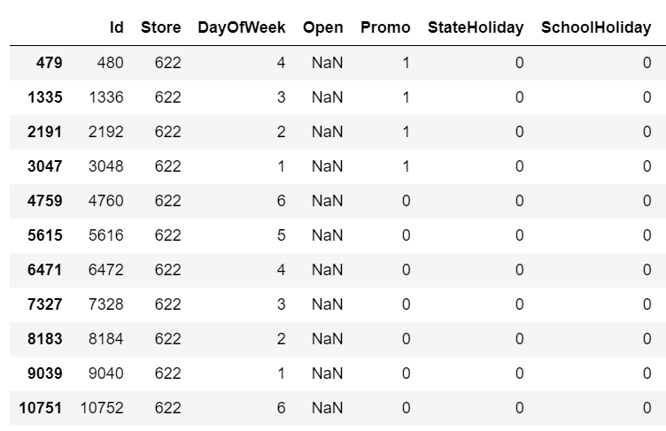
Pre-Processing
Data consists of 1million rows and 9 features.
Merged both ‘Store’ and ‘Train’ data and ‘Store’ and ‘Test’ data
Mapped the State Holiday ({0: 0, "0": 0, "a": 1, "b": 1, "c": 1}) for both train and test data.
Added a few other columns like ‘Month’, ’Average Customers’ and ‘Sales per customer’ for a better understanding of data.
Replaced missing values by calculating the median of the column.
Replaced the null values in test data ‘Open’ column with 1 as they are all in weekdays and not in holidays and converting it to float/int.

Slide 3
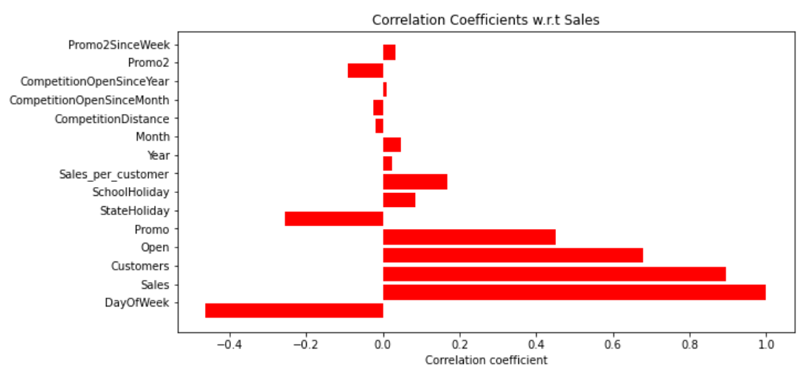
As you can see below there’s a very low correlation between ‘Promo2SinceWeek’, ‘Competition Open Since Year’, ‘Competition Open Since Month’, ’Competition Distance’. So, we dropped all these columns.

Slide 4
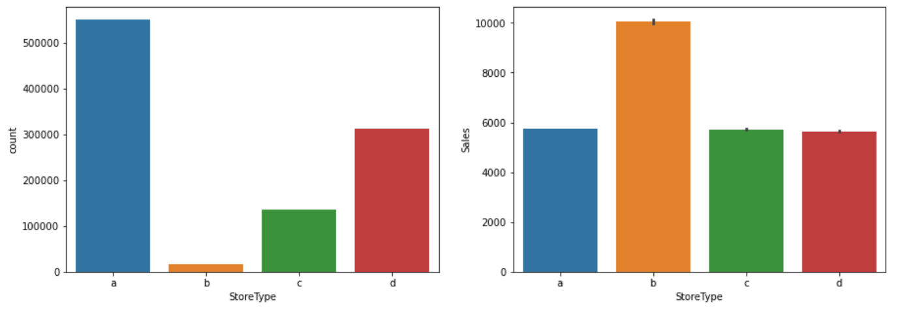
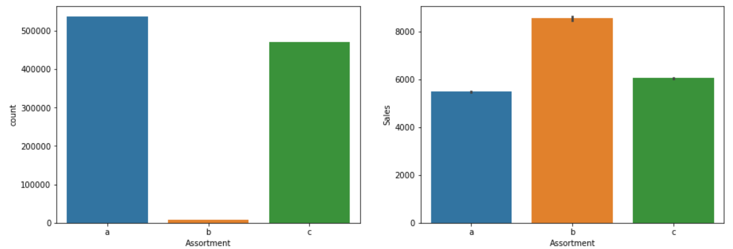
As you can see, even though the store types B, C & D are less in count, their sales are very high. So, they are relevant for predicting the sales.
Similarly, even though the Assortment type B are less in count, their sales are very high.

Slide 5
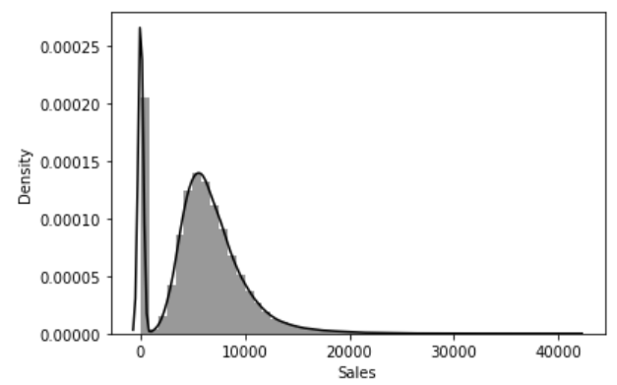
Removed rows where stores are closed, as Sales are zero
Copied the Id’s of rows in test data where store is closed and delete them, as the sales are 0. Finally, add them at the end with zero sales.

Slide 6
Did one-hot encoding for “Assortment, Day of Week and Store type” to convert the categorical variables to numerical variables.
Used Standard Scaler for scaling the data.

Slide 7
Deep Neural Network
Used Weight Initialization, activation function, optimizer and 3 dense layers of 32 neurons each.
Used Normal weight initializer to prevent layer activation outputs from exploding or vanishing during a forward pass through a deep neural network.
Used RELU Activation function as training a deep network with RELU tends to converge much more quickly and reliably than training with sigmoid activation.
Used Adam Optimizer as it changes the learning rate and momentum depending on the loss function. So, we don’t need to extensively give them, and it is too fast and converges rapidly.
Added DROPOUT layer to regularize the model/network.

Slide 8
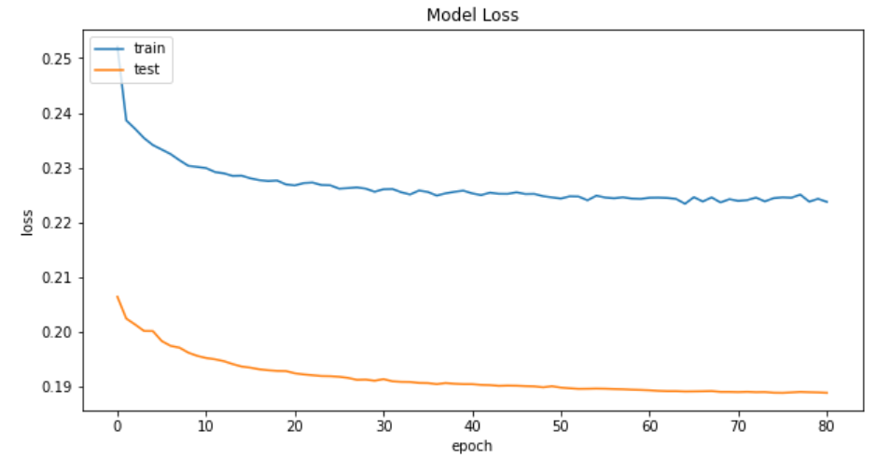
Used Early stopping as too many epochs can lead to overfitting of the training dataset, whereas too few may result in an underfit model.

Slide 9

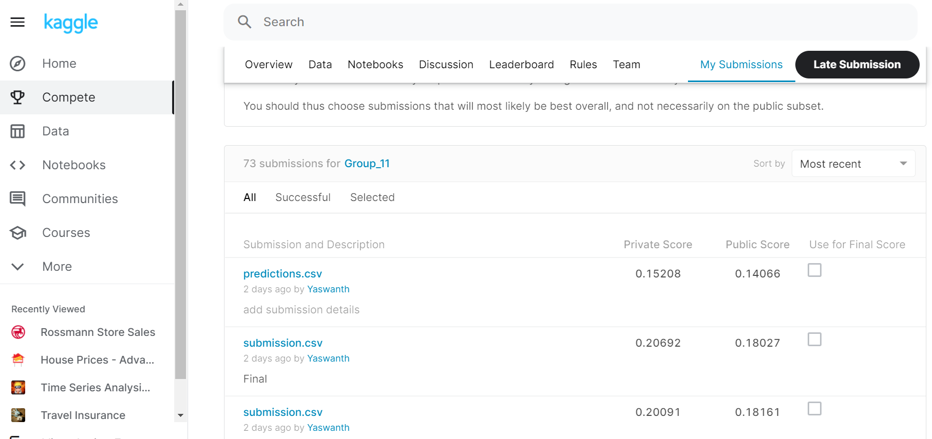



Final Score
We got the final score of 0.14

